Slide 1

World Bicycle Relief
Honglin Chen, Emily Gomez, Deepak Kumar, Rishabh Prakash, Daniel Renz

Slide 2
Business Model
World Bicycle Relief (WBR)
WBR aims to maximize the social impact of the company primarily through bicycle donations, as well as establishing bicycle mechanics and support in those areas.
Funding
Donations
Increased demand
Brand Recognition
Buffalo Bicycles Ltd. (BB)
BB is a for-profit social enterprise that further supports the operations of WBR by selling bicycles in viable markets.
Buy/Sell
Customers
Customers are broken into 2 segments: those receiving donated bicycles and those buying bicycles.
Revenue
Notes:
World Bicycle Relief (WBR) was founded in 2006 as a public charity. It works in countries including Kenya, Malawi, Zambia, and Zimbabwe. Its mission is to maximize the lasting impact in communities primarily through bicycle donations. However, donations alone cannot support the business long-term.
*** appear after click
Also, there are free markets that could benefit from durable bicycles so the subsidiary
Buffalo Bicycles Ltd. (BB) was created in 2008 as a for profit company. BB also supports WBR philanthropic efforts. This allows us to produce and donate more bicycles to have a larger impact.

Slide 3
Business Problem
What factors should WBR keep in mind to enter a new market in a Tier 1 country where it can take advantage of the strong cycling culture in the country to maximize its social impact through donating its bikes?
The distribution of bikes through WBR and BB serve to reduce inequality as well as increase opportunity and efficiency.

Slide 4
Proposed Models
MAX Social Impact
αq_{d} + (1-α)q_{s}
MAX Profit
Pq_{s} - Cq_{s} - Cq_{d}
q_{d} = quantity donated
q_{s} = quantity sold
α = % of bikes
q_{d} = quantity donated
q_{s} = quantity sold
P = price of bike sold
C = cost of bike produced
Notes:
WBR and BB are looking to expand operations into a new market. Our goal here today is to create a viable business model for this expansion. We thought about measures of success and what would be most appropriate. In alignment with our mission we created a model to maximize social impact. This means maximizing the number of bikes donated.

Slide 5
Social Impact Model

Slide 6









Parameters and Constraints
$147 Selling price
$116.75 cost per bike
Costs remain constant over the first 12 years
$4.5M original grant
N = 12 years
1 container = 800 bikes
No bikes are sold in the first year
> 15% donated
> 75% SOLD
Keep $100K in reserves
Notes:
WBR and BB are looking to expand operations into a new market. Our goal here today is to create a viable business model for this expansion. We thought about measures of success and what would be most appropriate. In alignment with our mission we created a model to maximize social impact. This means maximizing the number of bikes donated.

Slide 7
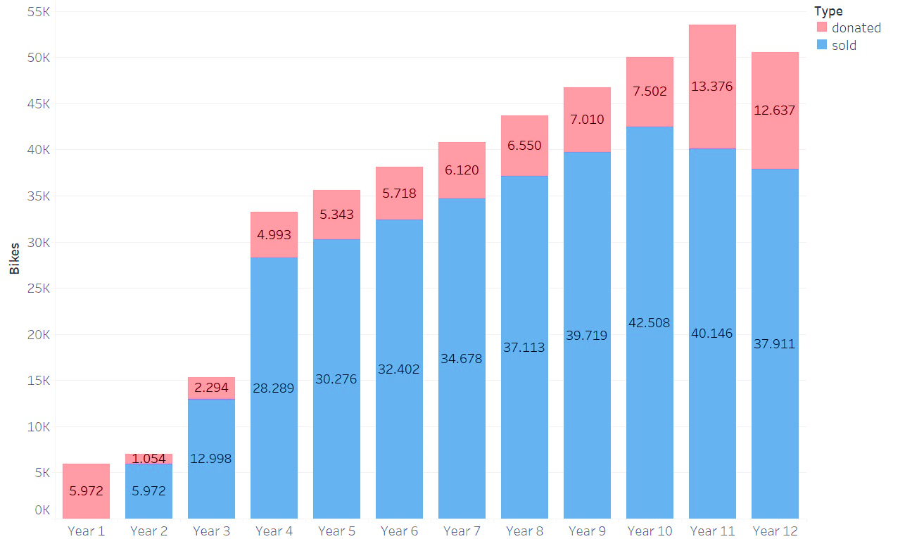
Optimal Solution
Number of bikes distributed each year
144,429* social impact
200,809 bikes in field after year 12
*formula multiplying bikes sold and donated by ratios in each category
Notes:
Bikes in the field after Y12 includes the ones sold and donated in the past 4 years because of the product lifecycle

Slide 8
Recommendations
At least 75% of distributed bikes must be sold
MAINTAIN A MINIMUM CASH BALANCE OF $100K/year
Potential new market:
india

Slide 9
Appendix

Slide 10
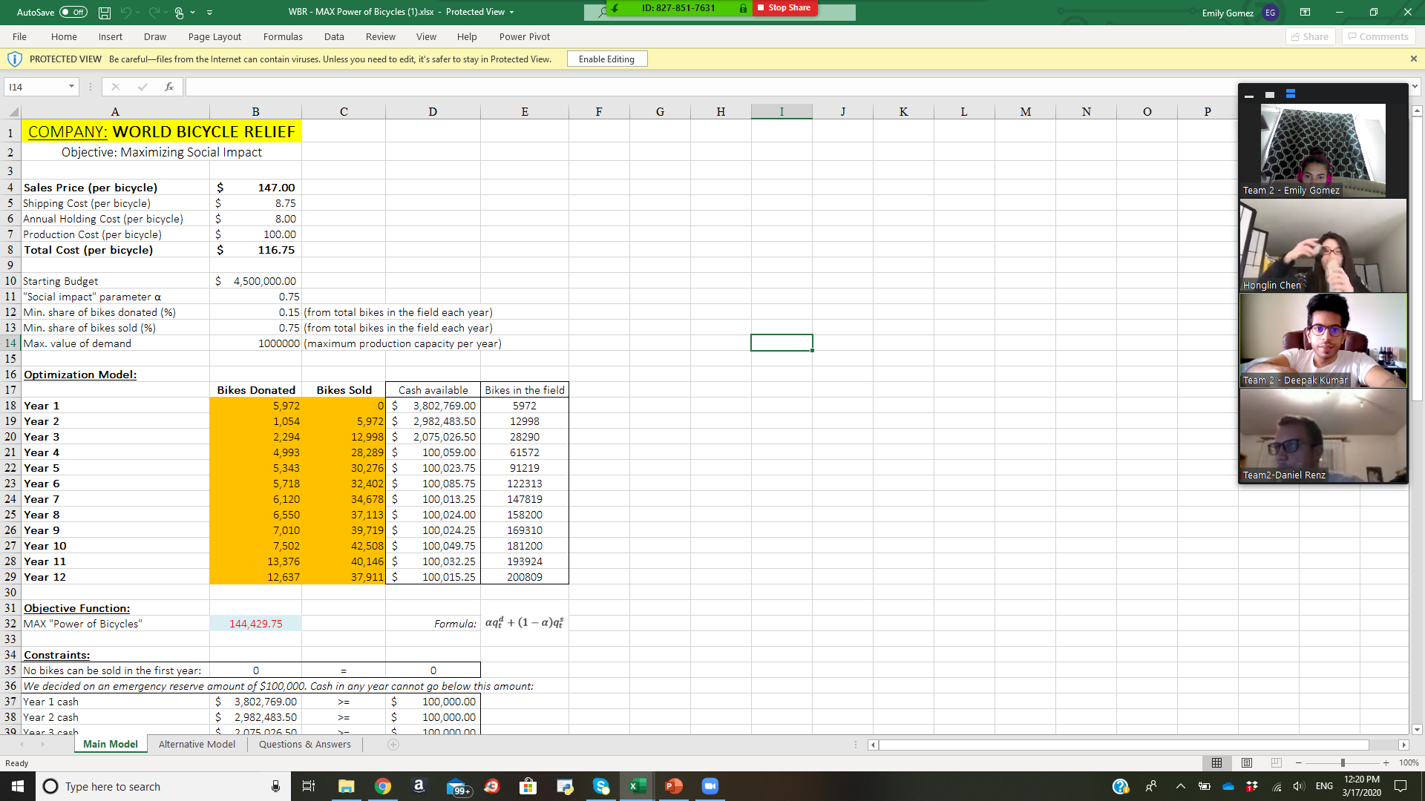
Bikes Distributed In Last 4 Years
Social Impact
Notes:
In our model we look at the first 12 years. This does not mean that all business stops after 12 years; however, our purpose today is building a viable model for ESTABLISHING ourselves in a new market, a generic type 1 country. As you can see, in the past 4 years we have distributed more than 200K bikes through WBR and BB and have a social impact value of over 144,000. Also note that our cash flows remain positive and we keep $100K at all times as both a business safety net and to ensure that we can continue to operate even when unexpected expenses or events unfold.

